Slide 1
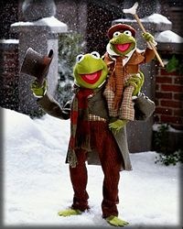
Just another source of conflict? writing disability in erotica
Charlie Powell

Slide 2
Can you identify the common disability tropes in these six stories?

Slide 3
Answers
1. A Christmas Carol: ‘saint-like’
2. Lady Chatterley’s Lover: asexual/infertile
3. Curious Incident of the Dog in the Night Time: differently-abled
4. What Katy Did: to teach someone a lesson
5. Hunchback of Notre Dame: unlovable
6. Peter Pan: physical indication of evil personality

Slide 4
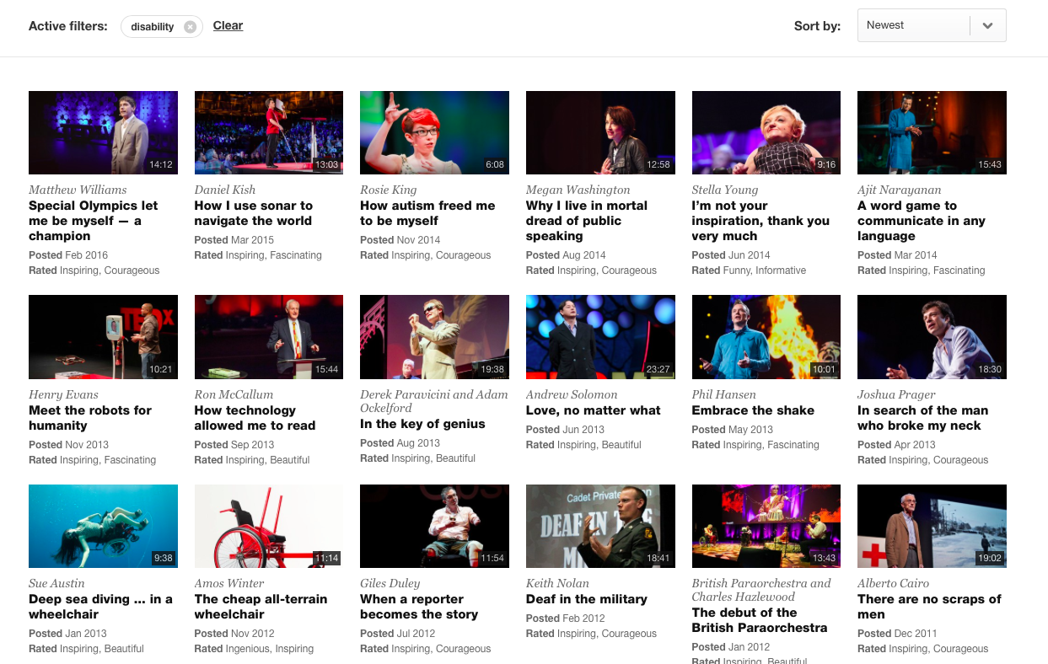
Inspiration: the modern disability trope
‘We have been sold this lie that disability makes you exceptional, and it absolutely doesn’t.’ – Stella Young

Slide 5
The reality
11 million disabled people in Britain (Source: Prime Minister’s Strategy Unit)
Over 7 million people or 18% of the working-age population in Britain are disabled as defined as by the Equality Act 2010 (Source: Employers' Forum on Disability).
Only 17% of disabled people were born with their disabilities (Source: Institute for Public Policy Research article Work for disabled people).
Only 8 per cent of disabled people in the UK use a wheelchair (Source: CSR Europe, ‘Disability: facts and figures' 2007).
One in four people will be affected by mental ill health in the course of their life (Source: Mind).
25% of the global population is either directly or indirectly affected by a disability (Source: UN and World Bank).

Slide 6
Writing disability can (and has) been done really well
‘The Theory of Everything is a biographical romantic drama film adapted from the memoir Travelling to Infinity: My Life with Stephen by Jane Wilde Hawking, which deals with her relationship with her ex-husband, theoretical physicist Stephen Hawking, his diagnosis of motor neurone disease, and his success in physics.’
(Wikipedia)

Slide 7
Disability works better as a character trait, not a plot point
It’s generally better not to make disability the main focus of your story – disability is not erotic in itself
The issue of disability doesn’t need to be resolved – it’s part of who your character is; they don’t need to be fixed/come to terms with it (even if society often thinks otherwise)
Having disabled characters in your story is as much about an accurate world-view as anything else

Slide 8
Exploit the fact that disabled people often have to be creative about sex…
‘Sensation play and kink are also crucial to my sexuality. Since I cannot feel many parts of my body, I have developed erogenous zones in some unique places – the most unique, perhaps, being the crook of my left elbow. By experimenting with different textures and sensations, I can discover different ways to give my body pleasure. Playing with bondage, light pain play, and role play scenarios cater to a fantasy-centered sex drive as well as allowing me to incorporate my entire body in sexual play.’ (Leandra Vane, Disability & sex stigma)

Slide 9
… and that sometimes, disability can be an advantage
‘When she took the blindfold off, I saw that my chest was covered in clothespins. (When you’re in your twenties, nipple clamps are expensive, so you work with what you have.) I’d never seen my body look like that. She must have been pretty impressed, because the first thing she said was, “I’ve never been able to do that before. Nobody has been able to take that many.”
It’s not often (i.e., almost never) that I get told I’m good at a physical activity. But now my body, which had spent so many years letting me down and making decisions without my consent, had gone and done something absolutely right — and done it better. It had done something other people’s bodies, “healthy” bodies, hadn’t been able to.’
(Carrie, Know Me Where It Hurts: Sex, Kink, and Cerebral Palsy, autostraddle.com)

Slide 10
Do your research…
‘The things that we’re overcoming are not the things you think they are. They are not things to do with our bodies.’ – Stella Young
The number of disability blogs out there means you can research disability more easily than ever before
BUT
Don’t assume disabled people will answer any questions you might have about their disability, especially when it comes to sex. The responsibility for research lies with you, not them.
AND
Accept that writing disability is scary, and you will get it wrong. That’s ok!

Slide 11
Exercise
‘If you could see the email thread that led to the publication of this guest blog, you’d think I had a fetish for Marks and Spencer. I don’t, though – honest. What I do have a thing for, though, is subtle public affection. Those snatched moments where you touch each other, or snog, or run a hand up under your partner’s clothes when you think that no one’s watching. So this guest blog, by Desire on Wheels, naturally presses a hell of a lot of my buttons. What’s more, it’s an insight into disability and sexuality that taught me more than I ever thought I’d know about early 20th century botanical gardens. You’ll see what I mean.’
– Girl on the net

Slide 12
Questions? sexblogofsorts@gmail.com

